Slide 1
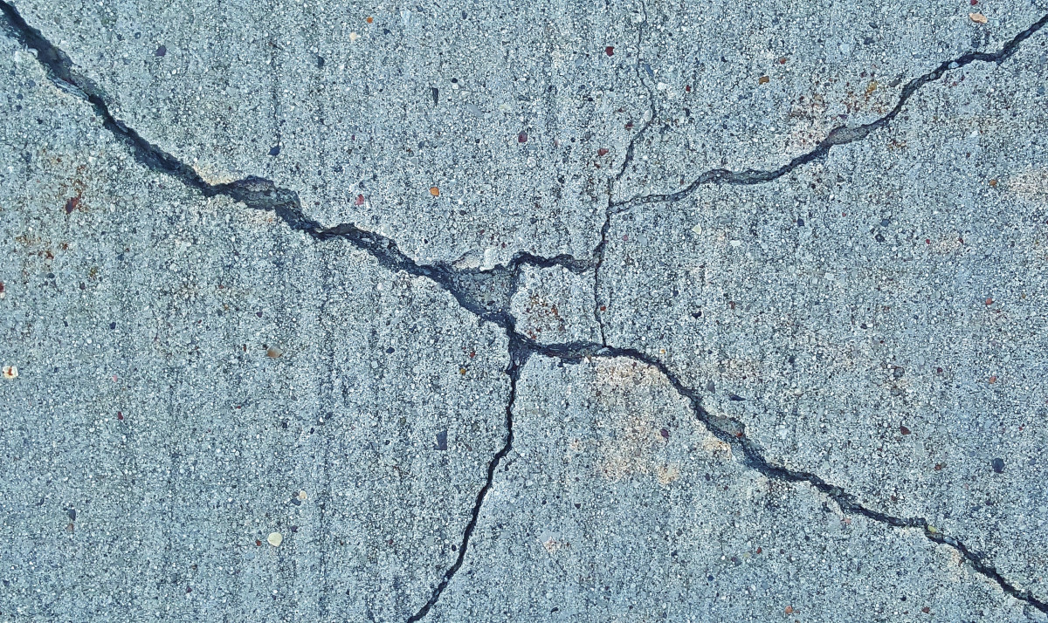
Earthquake magnitude in different locations

Slide 2
Data source
The data is collected from the USGS(U.S Geological Survey). The data set contains details of all earthquakes that have happened in the last 30 days and is updated every 15 mins in the USGS website. The data dictionary includes Latitude, longitude, depth, mag, magType, nst, gap, dmin, rms, net, id, updated, place, type, locationSource, magSource, horizontalError, depthError, magError, magNst, status. We will try to assess based on Place and Mag with Bar Graph, Pie Chart, Box Plot, Line Chart, Scatter Plot. This will help find the intensity on certain locations and possibly help on preventation.

Slide 3
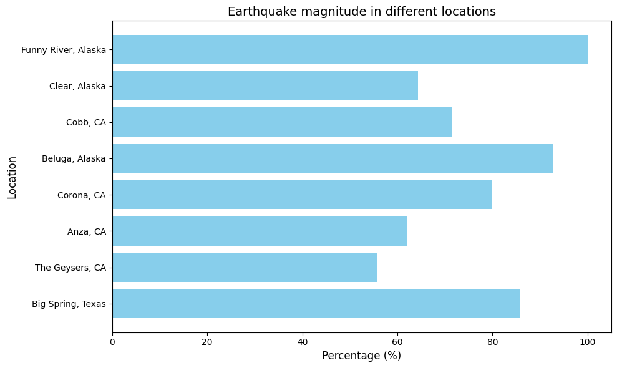
Bar Graph

Slide 4
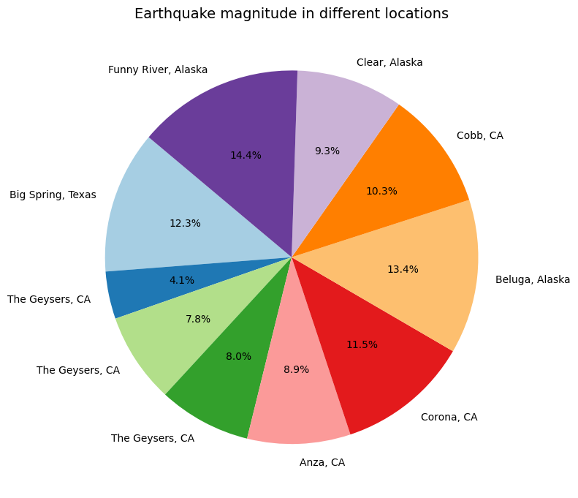
Pie chart

Slide 5
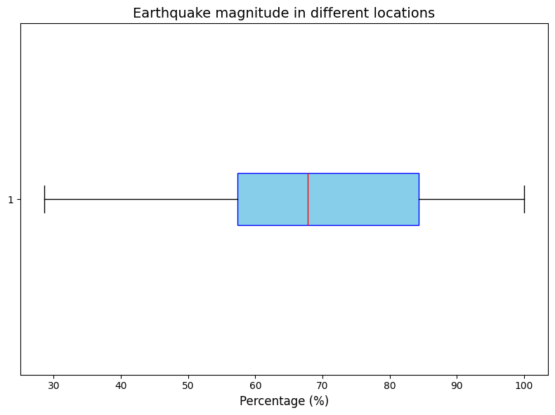
Box plot

Slide 6
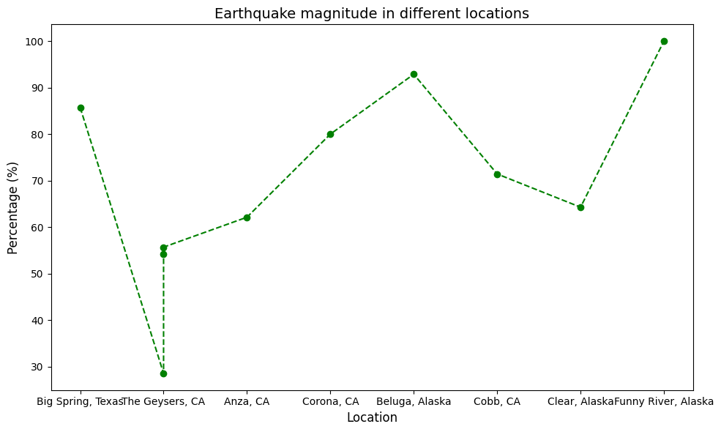
Line Chart

Slide 7
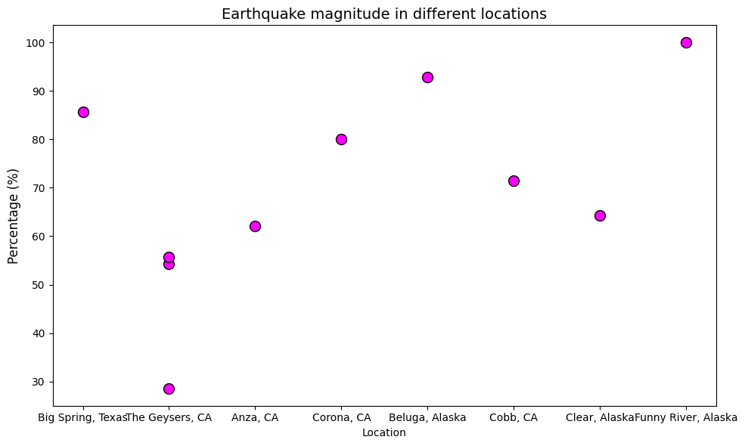
Scatter Plot

Slide 8
Conclusions
- The general observation is that the smaller earthquakes are frequent than larger ones
- Most earthquake percentages are concentrated between 50% and 100% of the maximum magnitude
- We can come to the conclusion that the highest magnitude is in Funny river Alaska and the lowest in the Geysers, CA.

